Slide 1
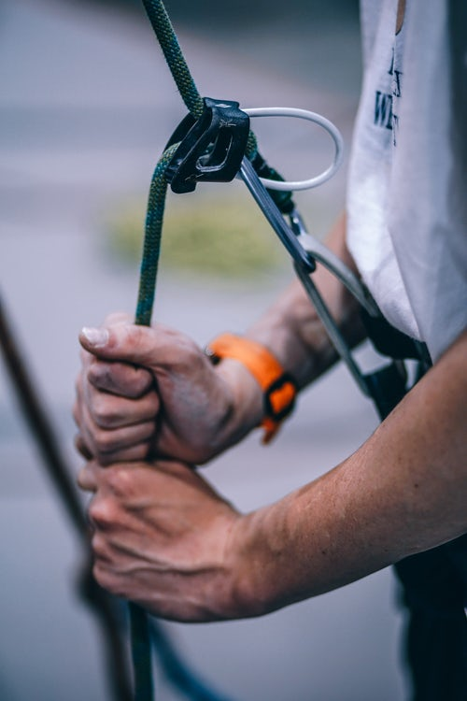
픈
Module 1
Exercises on Risk Assessment
Focused on Process Safety Management
Rohan P. Perera and Han-Gi Kim
Seminar on the CWC and Chemical Safety and Security Management for Member States in the Asia Region
National Committee for the Prohibition of Weapons Doha Regional Centre for CBRN Training
DOHA, QATAR 4 - 6 FEBRUARY 2020

Slide 2
GROUP- 01
Rafiqul Islam
Daloar Hossin Matubbr
Kingsley Rajapksha
Mohmmed Al Feel
Ahamed Almerikhi
Ali Alansari
Rashid Al Qamra
Saeed Alsulaiti
Mohd Almnsoori
Hamad Ali Almarri
Indersen Sewraj
Hamed Ibrahim
Al Barumi
Mohmmed Almarri
Mohammed Al Obaidi
Khalid Alsulaiti
Arwa Elahtem
Group members

Slide 3
픈
Memo

Slide 4
픈
Memo

Slide 5
FINDINGS
In the PT package we found following Information
The autoclave was changed with B ingredients & the process was run by using A instruction.it was a great mistake. They should be follow the process B
Process B need 110C, but it was 100C; so they need to increase the temperature
At process B required 110C’ so they increase 10C, it caused an uncontrollable pressure & the damage occurred

Slide 6
RECOMMENDATION
In process B, they should follow the instruction of B
we have to do the simulation for the temperature before the transformation

Slide 7
픈
Memo

Slide 8
픈
Memo

Slide 9
FINDINGS
I
We should conduct another PHA on this process
Reasons:
A mechanical Engineer should be incorporate in the team to identify the pump & it’s problem, because he knows the reason of failure
The Pump was air driven. Air with Isopropyl alcohol is flammable, so air should be replace with Nitrogen Gas & another PHA should be perform for one or two hours

Slide 10
RECOMMENDATION
We have to do the simulation for the temperature before the transformation

Slide 11
I
Q & A

Slide 12
Thank you
I
Giving this great opportunity to share the knowledge in terms of Chemical safety & security

